Slide 1
Policy instruments
Instruments recap
Coase Theorem
Weitzman Theorem
Tradable Emission Permits
International
European Union
United Kingdom
Border adjustments
Clean Development Mechanism
Technological change

Slide 2
Lectures
Science
Scenarios & emission reduction options
Costs of emission reduction
Instruments for emission reduction
Impacts and adaptation
Economic impacts of climate change
Reading week
Climate and development
Optimal emission reduction
Discounting, uncertainty, equity
International environmental agreements

Slide 3
Policy instruments
Instruments recap
Coase Theorem
Weitzman Theorem
Tradable Emission Permits
International
European Union
United Kingdom
Border adjustments
Clean Development Mechanism
Technological change

Slide 4
Direct Regulation
It is the most common form of environmental regulation, and highly successful in past management of point sources of toxic materials
Essentially, command and control prescribes aspects of the production process, be it inputs, production or outputs
Requires substantial knowledge on the part of the regulator
Requires relatively homogenous producers

Slide 5
Types of Direct Regulation
Inputs, e.g., fuel efficiency
Technology, e.g., catalytic convertors
Best practible means
Best available technology (not exceeding excessive costs)
Outputs
Products, e.g., carcinogenic toys
Waste, e.g., sulphur emissions
Timing, e.g., air traffic
Location, e.g., nature reserves
Prohibition, e.g., CFCs

Slide 6
Taxes and Subsidies
Taxes: Pay a charge or levy or penalty for every unit consumed, produced or emitted
Subsidies: Receive a premium for every unit not consumed, produced or emitted
Uniform taxes and subsidies have a uniform effect on marginal production costs, thus ensuring efficiency
Taxes and subsidies have an equivalent effect on emissions in the short run, but have different budgetary distributional, and long-term effects: Taxes increases costs, subsidies lower costs in polluting sectors

Slide 7
Taxes and Subsidies
Taxes: Pay a charge or levy or penalty for every unit consumed, produced or emitted
Subsidies: Receive a premium for every unit not consumed, produced or emitted
Different effects on emissions in the short-run?

Slide 8
If you reduce emissions, you pay less tax.
If you increase emissions, you pay more tax.

Slide 9
If you reduce emissions, you pay less tax, or get more subsidy.
If you increase emissions, you pay more tax, or get less subsidy.

Slide 10
Taxes and Subsidies
Taxes: Pay a charge or levy or penalty for every unit consumed, produced or emitted
Subsidies: Receive a premium for every unit not consumed, produced or emitted
Taxes and subsidies have the same effect on emissions in short-run
Uniform taxes and subsidies have a uniform effect on marginal production costs
This ensures cost-effectiveness (see below)
Same effect in the long-run?

Slide 15
Taxes and Subsidies
Taxes: Pay a charge or levy or penalty for every unit consumed, produced or emitted
Subsidies: Receive a premium for every unit not consumed, produced or emitted
Uniform taxes and subsidies have a uniform effect on marginal production costs, thus ensuring cost-effectiveness (see below)
Taxes and subsidies have an equivalent effect on emissions in the short run, but have different long-term effects
Taxes and subsidies have different budgetary, distributional effects too

Slide 16
Tradeable Permits
The government set an overall target on consumption, production or, most common, emission
Each producer obtains a certain amount of emission permits, can sell these, or buy more at the market place
If the permit market is perfect, all producers pay the same price, and marginal costs of production increase uniformly
Taxes and tradeable permits are equivalent provided that the regulator knows all marginal abatement costs

Slide 17
Tradeable Permits
The government sets an overall target on consumption, production or, most common, emissions
Each producer obtains a certain amount of emission permits, can sell these, or buy more at the market place

Slide 20
Tradeable Permits
The government sets an overall target on consumption, production or, most common, emissions
Each producer obtains a certain amount of emission permits, can sell these, or buy more at the market place
If the permit market is perfect, all producers pay the same price, and marginal costs of production increase uniformly
Taxes and tradeable permits are equivalent provided that the regulator knows all marginal abatement costs -- see below

Slide 21
Policy instruments
Instruments recap
Coase Theorem
Weitzman Theorem
Tradable Emission Permits
International
European Union
United Kingdom
Border adjustments
Clean Development Mechanism
Technological change

Slide 22
Permits: Initial Allocation
Grandparenting
Give permits to current emitters
Politically easy, as confirms status quo
Market starts without a price
Auctioning
Sell permits to highest bidder
Generates revenue, perhaps a lot
Cap & trade almost like a tax, except for price variability
To victim
Perhaps fair, definitely complicated
Would generate large transfers
Per capita
Perhaps fair, relatively easy
Would generate large transfers

Slide 23
Coase Theorem: Preliminaries
Marginal costs of emission reduction
Marginal benefits of emission reduction
Price
p*
q*
Quantity

Slide 24
Coase Theorem: Polluter pays
Marginal costs of emission reduction
Marginal benefits of emission reduction
Price
Willingness to compensate pollutee
p*
Compensation needed for pollution
q*
Quantity

Slide 25
Coase Theorem: Pollutee pays
Marginal costs of emission reduction
Marginal benefits of emission reduction
Price
Compensation needed not to pollute
p*
Willingness to compensate polluter
q*
Quantity

Slide 26
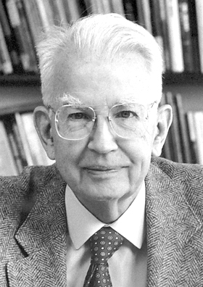
Coase Theorem
The Coase Theorem separates efficiency and equity
Regardless of the initial allocation of property rights, the market will find the same allocation
The initial allocation: Who pays what
The final allocation: Who does what

Slide 27
Policy instruments
Instruments recap
Coase Theorem
Weitzman Theorem
Tradable Emission Permits
International
European Union
United Kingdom
Border adjustments
Clean Development Mechanism
Technological change

Slide 28
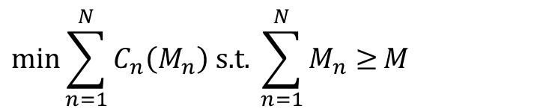
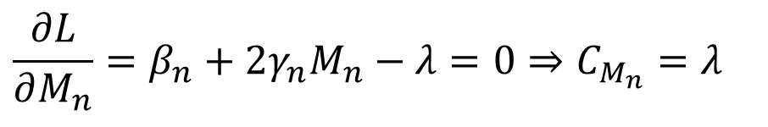
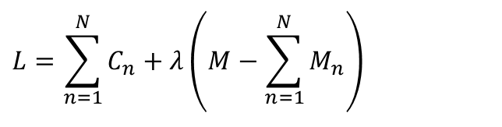

Cost-effectiveness
$$C_{n}=β_{n}M_{n}+γ_{n}M_{n}^{2}$$
Marginal costs are equal for all producers
$$\min{\sum_{n=1}^{N}{C_{n}\left(M_{n}\right) \text{s}\text{.}\text{t}\text{. }\sum_{n=1}^{N}{M_{n}≥}M}}$$
$$L=\sum_{n=1}^{N}{C_{n}}+λ\left(M−\sum_{n=1}^{N}{M_{n}}\right)$$
$$\frac{∂L}{∂M_{n}}=β_{n}+2γ_{n}M_{n}−λ=0⇒C_{M_{n}}=λ$$

Slide 29
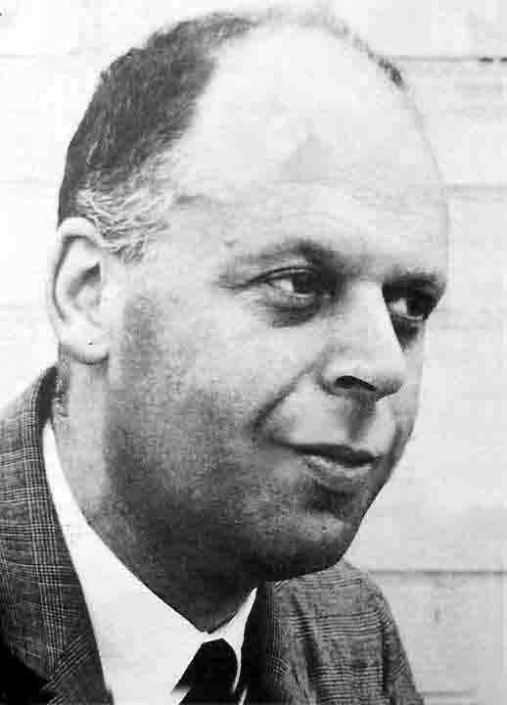
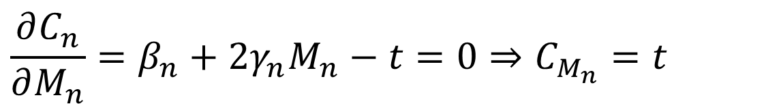
Cost-effectiveness
$$C_{n}=β_{n}M_{n}+γ_{n}M_{n}^{2}−tM_{n}$$
Marginal costs are equal for all producers
$$\frac{∂C_{n}}{∂M_{n}}=β_{n}+2γ_{n}M_{n}−t=0⇒C_{M_{n}}=t$$
$$C_{n}=β_{n}M_{n}+γ_{n}M_{n}^{2}−pM_{n}$$
$$C_{n}=β_{n}M_{n}+γ_{n}M_{n}^{2}+sM_{n}$$

Slide 30
Cost-Effectiveness
Market-based instruments are cost-effective, as every polluter faces the same tax, subsidy or permit price
Command and control is unlike to be cost-effective, unless the regulator knows a lot and the industry is homogenous

Slide 31
Policy instruments
Instruments recap
Coase Theorem
Weitzman Theorem
Tradable Emission Permits
International
European Union
United Kingdom
Border adjustments
Clean Development Mechanism
Technological change

Slide 32
Environmental Effectiveness
The environmental effect of taxes and subsidies is uncertain (but its marginal costs are certain)
The environmental effect of tradeable permits is certain (but its costs are uncertain)
The environmental effects of emission standards are certain (bar illegal dumping), of input and production standards less certain

Slide 33
Weitzman Theorem: Preliminaries
True marginal costs
Assumed marginal costs
Marginal damages
Price
p’
p*
Price instrument: overregulation
Welfare loss underregulation
Welfare loss overregulation
p”
q”
q*
q’
Quantity
Quantity instrument: underregulation

Slide 34
Weitzman Theorem: MD steeper than MC
Marginal damages
True marginal costs
Assumed marginal costs
Price
p’
p*
Price instrument: overregulation
Welfare loss underregulation
Welfare loss overregulation
p”
q”
q*
q’
Quantity
Quantity instrument: underregulation

Slide 35
Weitzman Theorem: MD less steep than MC
True marginal costs
Assumed marginal costs
Price
Marginal damages
p’
p*
Price instrument: overregulation
Welfare loss underregulation
Welfare loss overregulation
p”
q”
q*
q’
Quantity
Quantity instrument: underregulation

Slide 36
Weitzman Theorem: MD as steep as MC
True marginal costs
Assumed marginal costs
Marginal damages
Price
p’
p*
Price instrument: overregulation
Welfare loss underregulation
Welfare loss overregulation
p”
q”
q*
q’
Quantity
Quantity instrument: underregulation

Slide 37
Weitzman Theorem
If the marginal damage cost curve is less steep than the marginal abatement cost curve, then mistakes with price instruments (taxes) are less costly than are mistakes with quantity instruments (tradable permits)
If the marginal damage cost curve is steeper than the marginal abatement cost curve, then mistake with quantity instruments (tradable permits) are less costly than are mistakes with price instruments (taxes)

Slide 38

Weitzman Theorem
If environmental pollution is a stock variable, pollution would not be very sensitive to changes in emissions and the marginal damage cost curve would be relatively flat, that is, not vary much with emissions
In this case (e.g., climate change, biodiversity loss), taxes are preferred over tradable permits
https://richardtol.shinyapps.io/Weitzman/

Slide 39
Policy instruments
Instruments recap
Coase Theorem
Weitzman Theorem
Tradable Emission Permits
International
European Union
United Kingdom
Border adjustments
Clean Development Mechanism
Technological change

Slide 40
International Emissions Trade
Kyoto Protocol / Marrakech Accords
Emissions trade in the OECD
Joint Implementation (project based) between OECD and Countries in Transition
Clean Development Mechanism (project based) between OECD and Less Developed Countries
Within the EU, there is the Emissions Trading Scheme/System, and one for aviation
1 permit market in NE USA, 1 California+Quebec, Ontario, Nova Scotia, 9+1 in China, New Zealand, South Korea, Switzerland, UK, Germany and Kazakhstan (?)
Note that a single market creates a single price – 21 markets means 21 prices

Slide 41
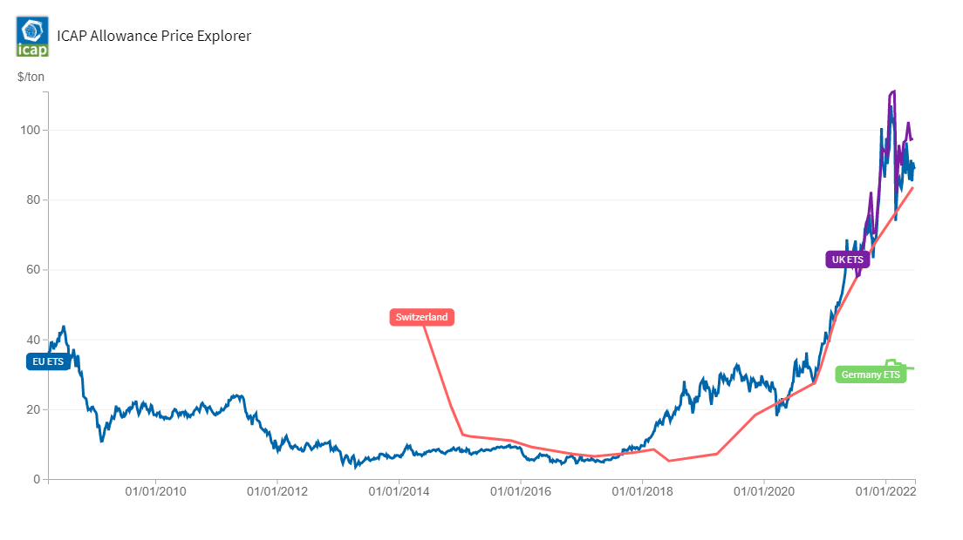

Slide 42
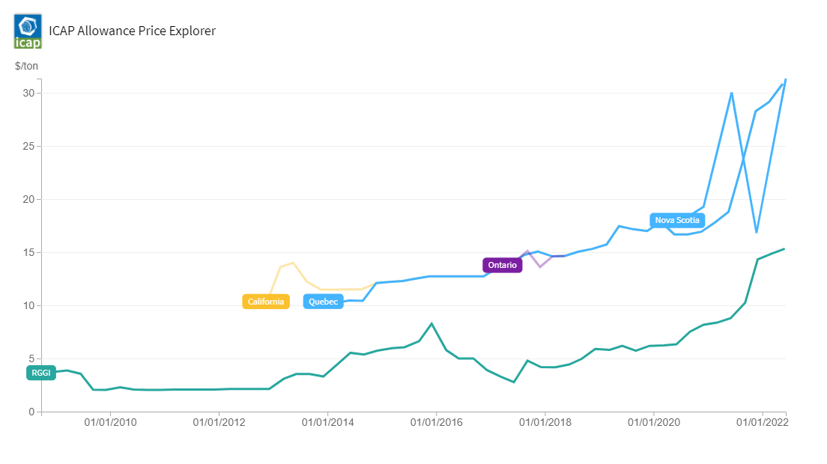

Slide 43
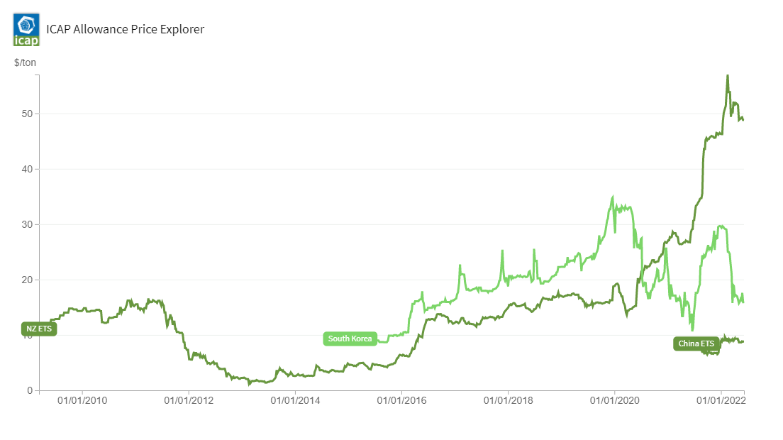

Slide 44
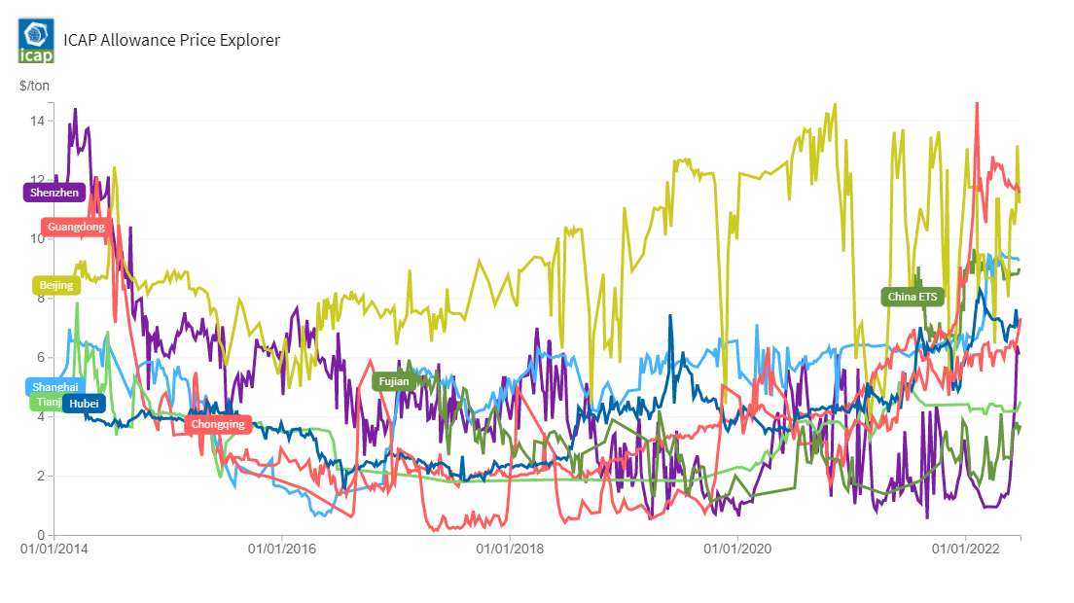

Slide 45
Can permit markets be coupled?
Long distance trade is older than the nation state
Permits are not goods, however, but government licenses
International permit trade thus requires government acts of mutual recognition
Heterogeneity in permits (monitoring, enforcement, definition) can be accommodated, e.g., through a rating system
Permit markets do not fall under WTO, so trade can be regulated at will
Can ... but is not ... regulators have been reluctant to accept each other’s permits

Slide 46
Policy instruments
Instruments recap
Coase Theorem
Weitzman Theorem
Tradable Emission Permits
International
European Union
United Kingdom
Border adjustments
Clean Development Mechanism
Technological change

Slide 47
EU Emissions Trading System
Covers part of carbon dioxide, some nitrous oxide
Mid-stream trade
Grandparenting of permits – capital subsidy of billions of euros
Gradual transition to auctioning (40% in 2013, 57% in 2020), to be completed by 2020 2030
Banking (after 2012) but not borrowing
Full banking and borrowing 2008-12, 2013-2020, 2021-2030
Fines for excess emissions

Slide 49
Teething issues?
Initial allocation by Member States – beggar thy neighbour – oversupply
European Commission is now in charge
Electronic registries were hacked
Rumania did not monitor for a while
Carousel fraud (€300 mln uncovered)
VAT rules standardised in 2010
Monitoring and enforcement with the Member States

Slide 50
Policy instruments
Instruments recap
Coase Theorem
Weitzman Theorem
Tradable Emission Permits
International
European Union
United Kingdom
Border adjustments
Clean Development Mechanism
Technological change

Slide 51
UK ETS
The UK ETS “started” on 1 Jan 2021
This was not necessary
Iceland, Liechtenstein and Norway
UK dithered about whether or not to stay in the EU, which meant that UK companies lost their free allocation of permits in 2018
One factor in the bankruptcy of British Steel
HMG not sure carbon tax or tradable permits
First trade was on 19 May 2021
UK ETS is a carbon copy of EU ETS
except Cost Containment Mechanism
If average price is greater than price of previous 2 years for 3 months in a row, then nothing happens

Slide 53
UK ETS
Average price in 2021 £55.59/tCO2
Average price in EU: €49.43/tCO2 = £41.34/tCO2
Number of permits: 84 mln tCO2
Cost: £14.15/tCO2 * 84,867,000 tCO2 = £1,200,868,050

Slide 54
Policy instruments
Instruments recap
Coase Theorem
Weitzman Theorem
Tradable Emission Permits
International
European Union
United Kingdom
Border adjustments
Clean Development Mechanism
Technological change

Slide 55
Border adjustments
Allocation in EU and UK ETS is a mix of auctioned and grandparented permits
EU has long tried to reduce grandparenting
Grandparenting continues in sectors that are exposed to international trade
Domestic steel, with a carbon price, competes with imported steel, without a carbon price
These sectors receive free permits, which is essentially a capital subsidy

Slide 56
Border adjustments
The EU hopes to introduce a border adjustment in lieu of grandparenting
Under WTO rules, an emissions tax on domestic production can be rebated on exports, levied on imports
The main disputes are over whether foreign production is not discriminated against
Tradable permits are no taxes, however
EU will issue certificates, sell to importers at the permit price
Certificates are not permits: No cap on imported emissions

Slide 57
Policy instruments
Instruments recap
Coase Theorem
Weitzman Theorem
Tradable Emission Permits
International
European Union
United Kingdom
Border adjustments
Clean Development Mechanism
Technological change

Slide 58
Clean Development Mechanism
CDM allows rich countries to invest in emission reduction in poor countries
Poor countries do not have emission targets, so the trade is in Certified Emission Reduction credits (CERs)
CERs are project-based, difference between emissions as they would be with and without the project
There is therefore a hefty bureaucracy, which excludes smaller projects and poorer countries, and drives a price wedge between ETS and CER

Slide 59
Clean Development Mechanism -2
Projects can meet all criteria without reducing emissions
Closing a factory (without reducing overall supply) would earn CERs
The carbon value of HFC23 far exceeds its market value. It is profitable to build an HFC23 plant, plan to turn it on, sell the carbon credits instead, break it down again, and rebuild under a different name in a different location
Now forbidden

Slide 60
Policy instruments
Instruments recap
Coase Theorem
Weitzman Theorem
Tradable Emission Permits
International
European Union
United Kingdom
Border adjustments
Clean Development Mechanism
Technological change

Slide 61
Technological progress
If technological progress can be accelerated and directed towards carbon-neutral energy, costs of emission reduction would fall substantially

Slide 64
Technological progress
If technological progress can be accelerated and direct towards carbon-neutral energy, costs of emission reduction would fall substantially
Just redirecting technology may be very expensive, as climate policy would come at the expense of economic growth, medical care and so on
How can this be done?

Slide 65
Externalities and risks
Knowledge can be copied – it spills between companies and countries
That implies that the innovator will not reap the full benefits, which means that there is underinvestment in research and development
R&D is a risky investment
Knowledge production is uncertain
Future market is uncertain
More underinvestment
Policies that accelerate R&D thus increase welfare

Slide 66
Three types
Invention
Something new
Innovation
Bring the invention to the market
Diffusion
From niche application to mass market
The climate problem can be solved by innovation and diffusion, but invention would help

Slide 67
Technology instruments for innovation
Patents
Temporary monopoly
R&D subsidies
Inputs not output
Picking winners
Government procurement
Conditional procurement
Guaranteed purchase
Conditional monopoly
Prize
Predictable price signals
Taxes better than tradable permits

